Slide 1
Linux Assembly
Armine Hayrapetyan

Slide 2
Outline
Introduction to Files
Open Files
Writing Files
Reading Files

Slide 3
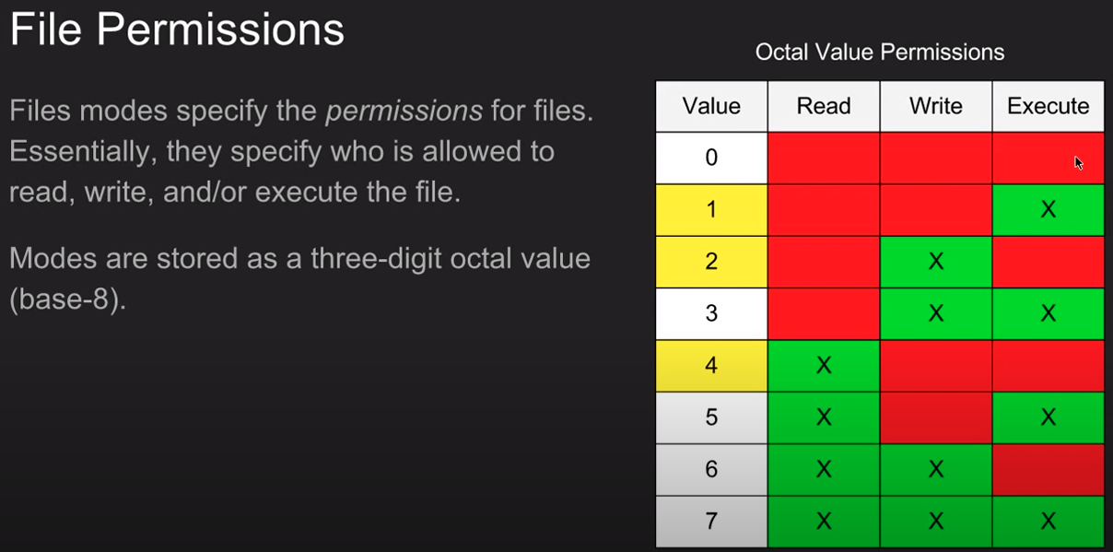

Slide 4
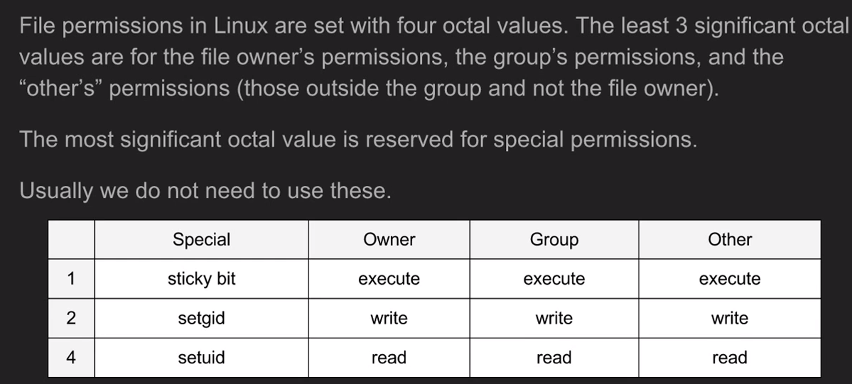
File Permissions

Slide 5
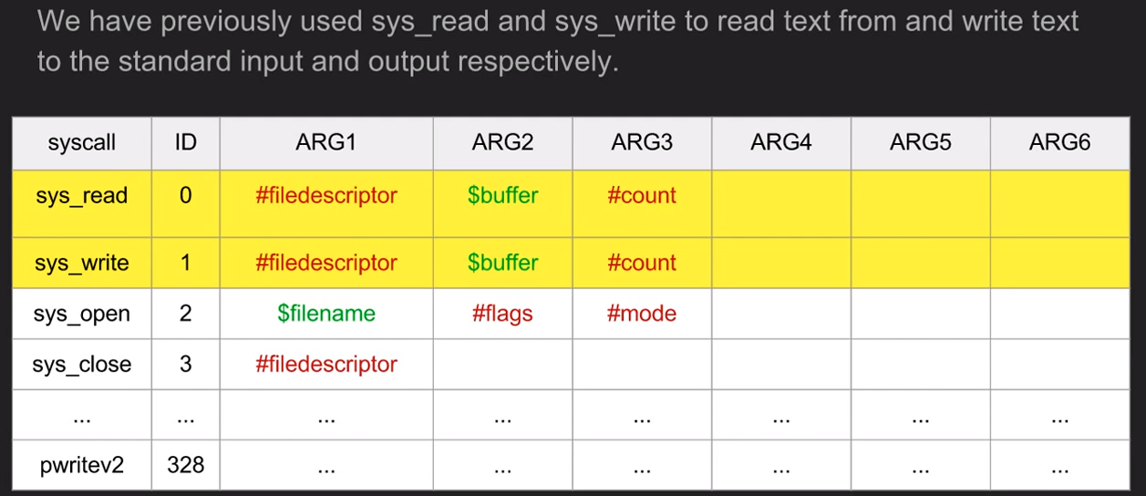
System Calls

Slide 6
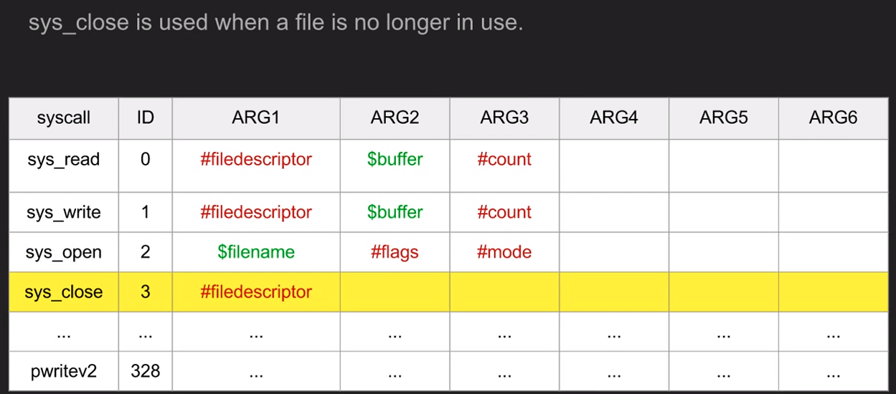
System Calls

Slide 7
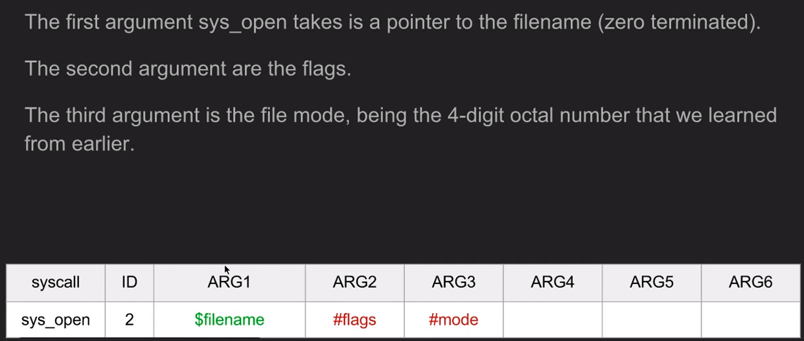
sys_open

Slide 8
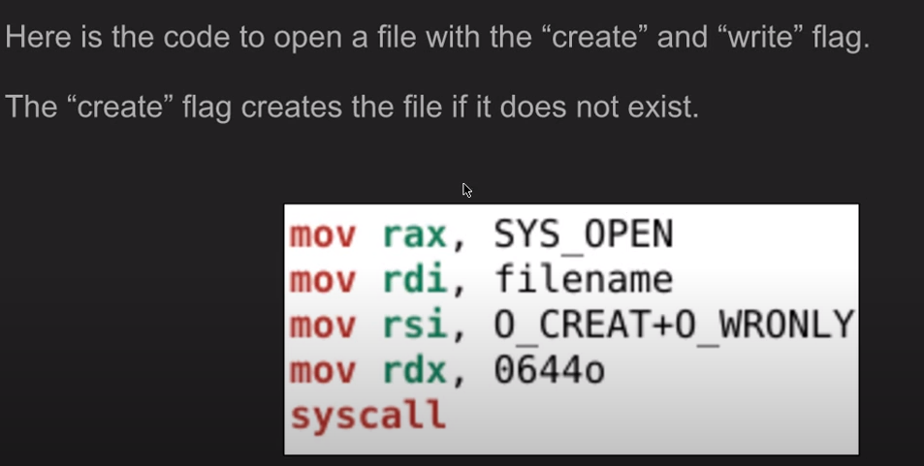
sys_open

Slide 9
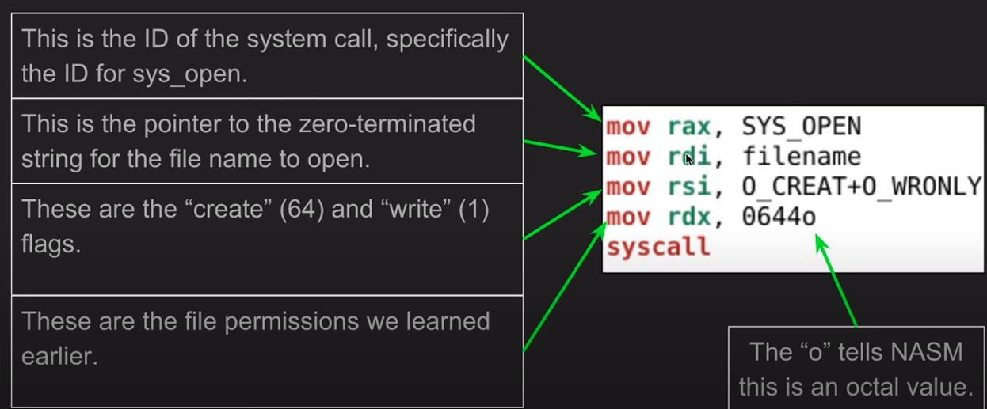
sys_open

Slide 10
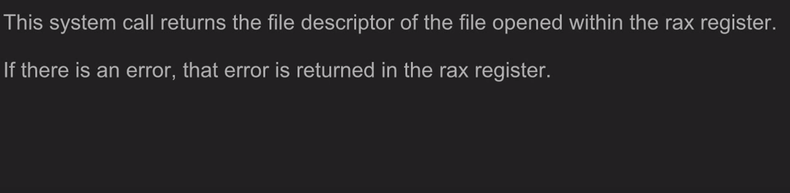
sys_open

Slide 11
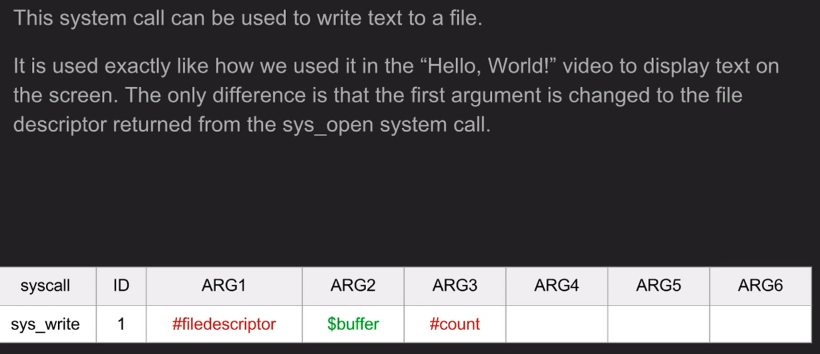
sys_write

Slide 12
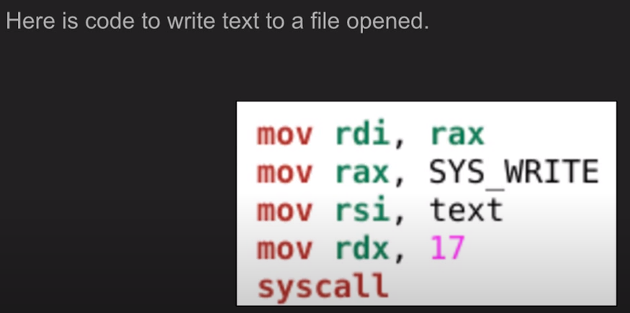
sys_write

Slide 13
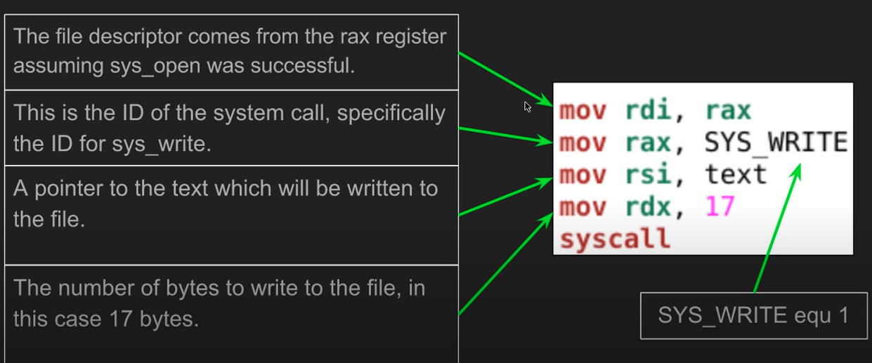
sys_write

Slide 14
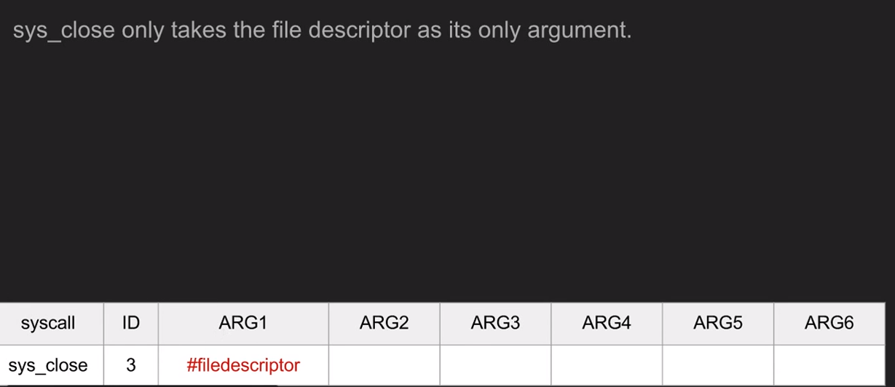
sys_close

Slide 15
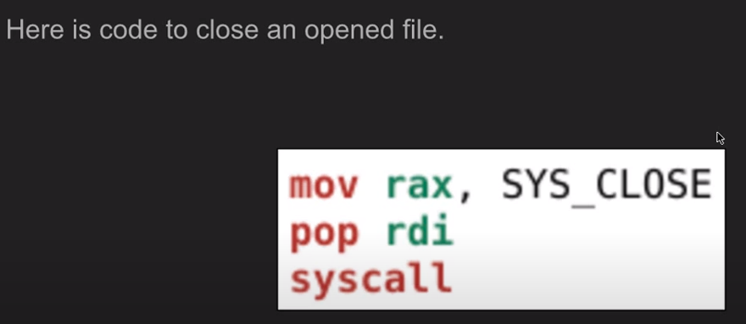
sys_close

Slide 16
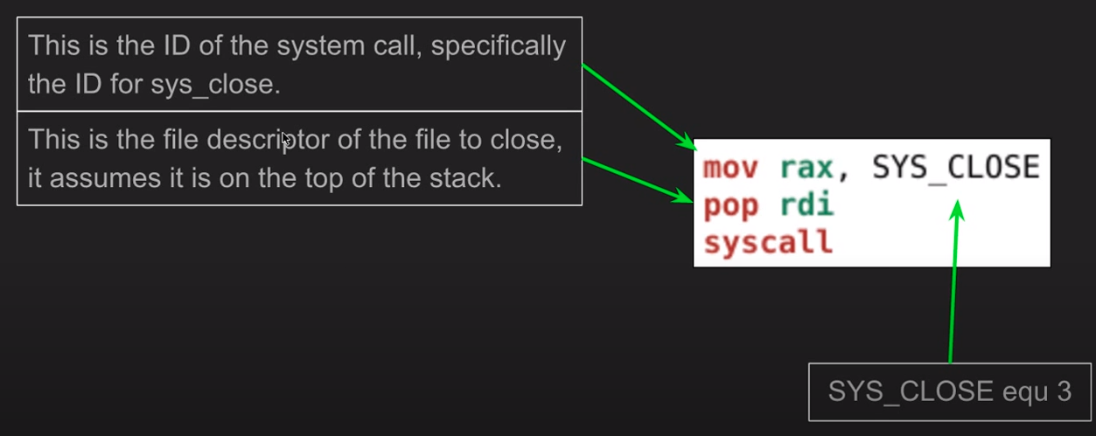
sys_close

Slide 17
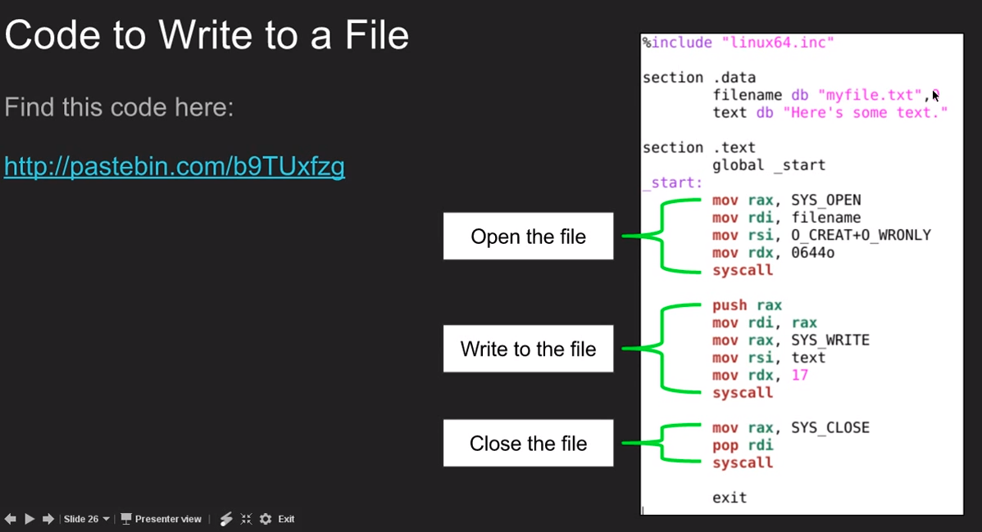

Slide 18
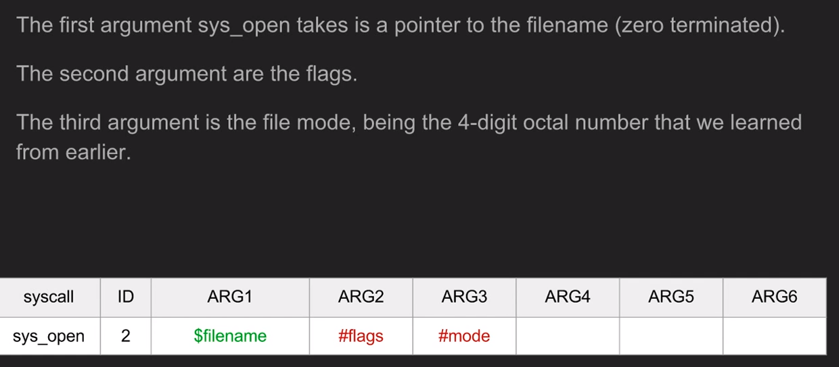
sys_open

Slide 19
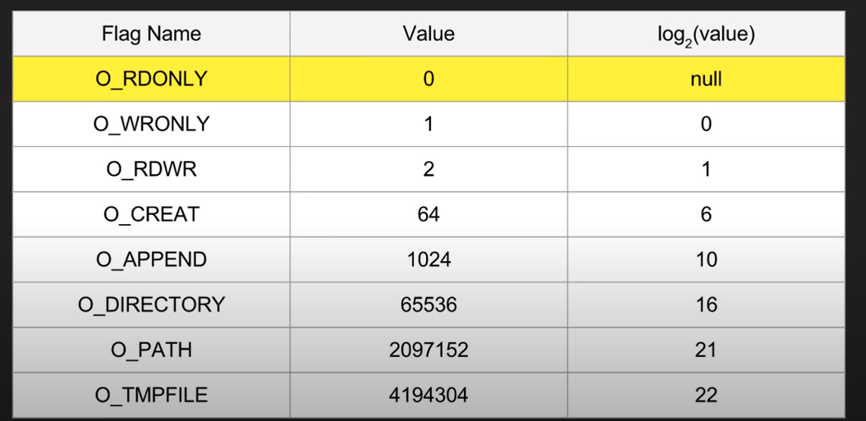
sys_open

Slide 20
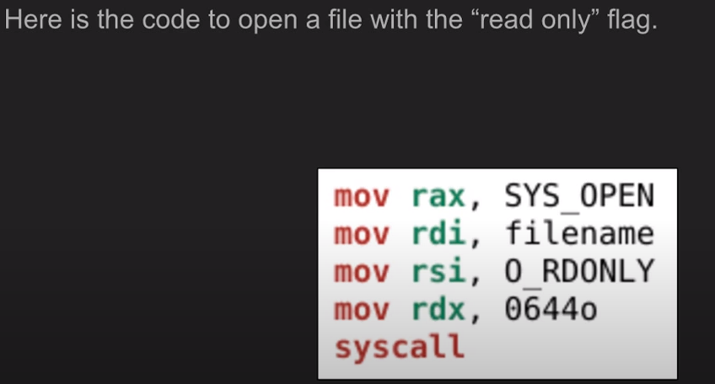
sys_open

Slide 21
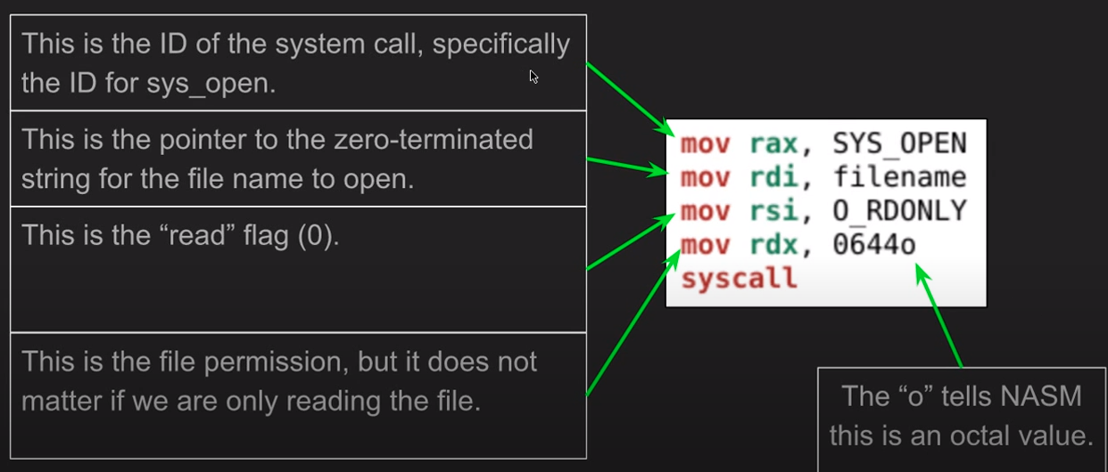
sys_open

Slide 22
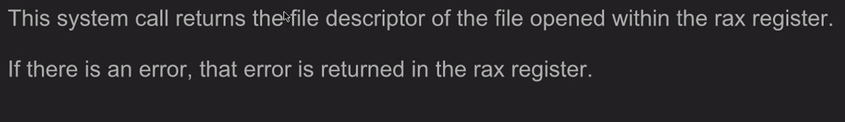
sys_open

Slide 23
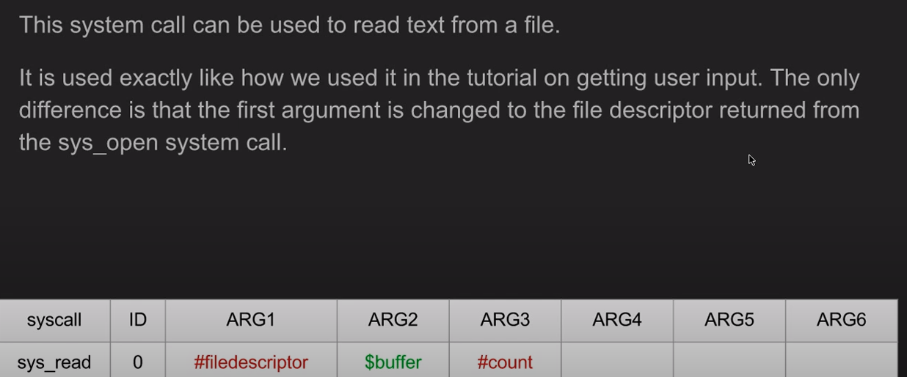
sys_read

Slide 24
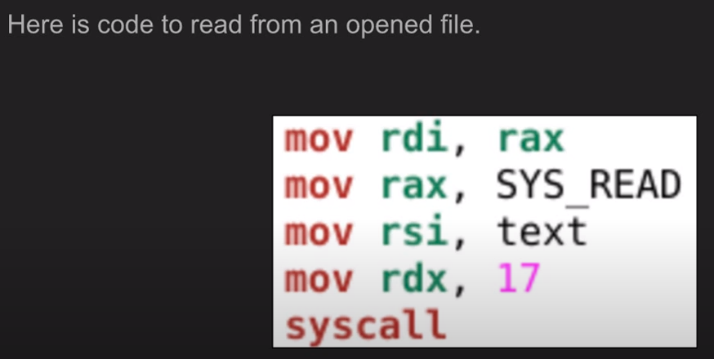
sys_read

Slide 25
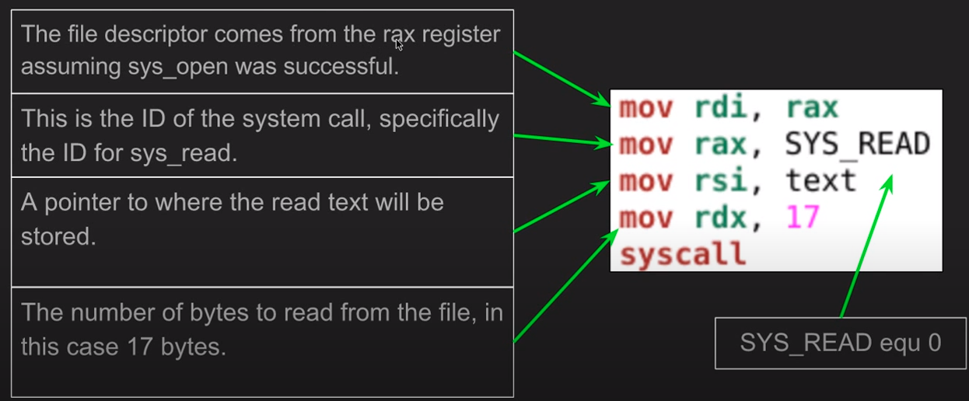
sys_read

Slide 26
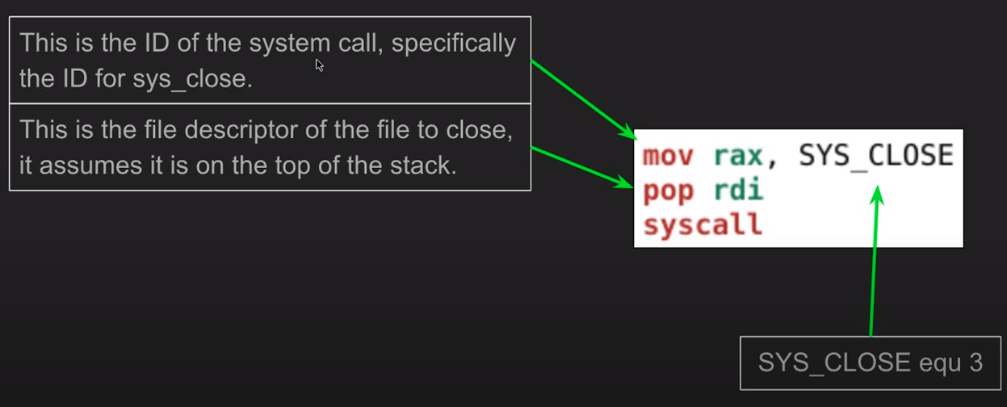
sys_close

Slide 27
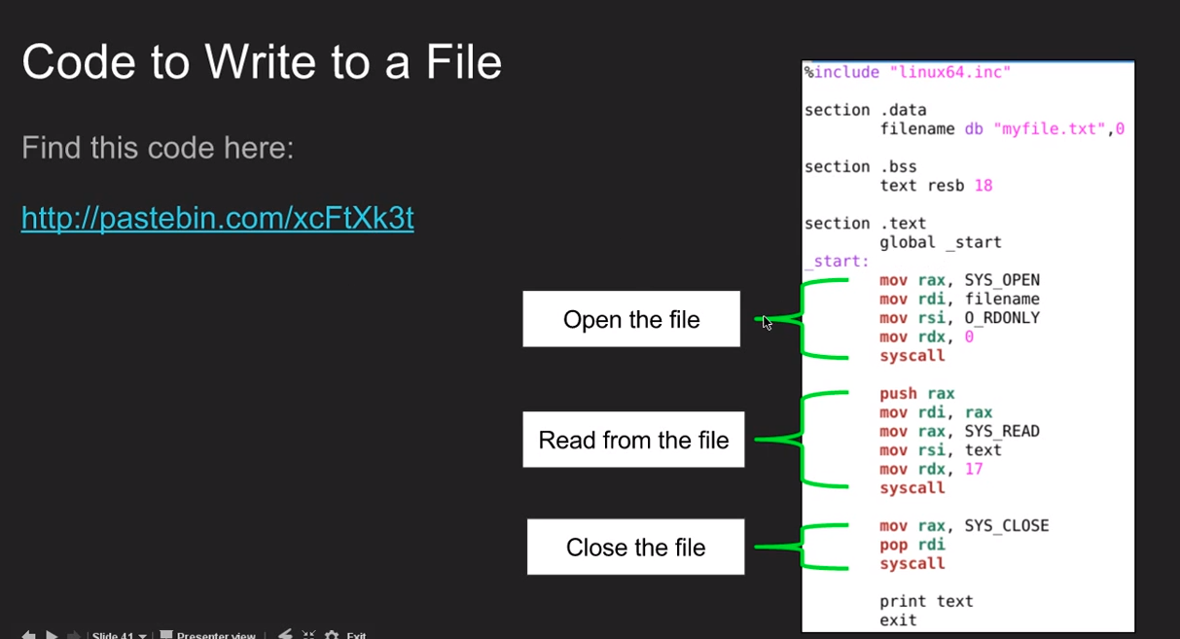

Slide 28
References
https://www.youtube.com/watch?v=AwmhZUATGYM&list=PLetF-YjXm-sCH6FrTz4AQhfH6INDQvQSn&index=10
https://www.youtube.com/watch?v=vXsUIX_Ozgc&list=PLetF-YjXm-sCH6FrTz4AQhfH6INDQvQSn&index=11
https://www.youtube.com/watch?v=vXsUIX_Ozgc&list=PLetF-YjXm-sCH6FrTz4AQhfH6INDQvQSn&index=12

